Slide 1

3D Vision LLM
3D OBJECT CAPTIONING - WEEK #4
8-15-2024
Submitted by:
Mr. FAZZA Abdellah - ENSAM Casablanca (Big Data & IoT)
3D SMART FACTORY

Slide 2








3D-FUTURE: 3D Furniture shape
ABO
Datasets
The 3D-FUTURE dataset is a richly-annotated, large-scale repository of 3D furniture shapes with high-resolution textures and detailed geometries,
The Amazon Berkeley Objects (ABO) dataset is a large-scale collection of product images, metadata, and artist-created 3D models with complex geometries and materials.
Cap3D
Objaverse
Objaverse 1.0 is a large-scale dataset of over 800,000 3D models with captions, tags, and animations, designed to improve upon current 3D repositories.
3D-text pairs generated by Cap3D from the paper: Scalable 3D Captioning with Pretrained Models
Datasets
ShapeNet
ModelNet
ShapeNet is a richly-annotated, large-scale repository of over 3,000,000 3D CAD models organized into 3,135 categories under the WordNet taxonomy, featuring semantic annotations like alignments, parts, symmetry planes, and physical sizes.
offers a comprehensive, clean collection of 3D CAD models for objects, organized into common categories derived from the SUN database, with human-verified categorization and alignment.
1

Slide 3


Pipeline (Reminder)
Image Captioning
Caption Selection
Captions Fusing
Rendering
2

Slide 4






Rendering: Render a set of 2D views for each 3D object
Script Rendering using Blender (Break-down)
Helper Functions
Setup and Initialization
Normalize and center the object. Position camera based on the object's size. Render object from 8 different viewpoints
Blender Configuration
Import necessary libraries.
Load 3D object file paths.
Set up Blender to use the Cycles render engine and configure it to use GPU.
Main Rendering Loop
Scene Preparation
Output Directory Setup
create a consistent set of renderings for each object from multiple angles.
Delete default cube.
A three-point lighting setup is created.
Store rendered images and camera matrices.
3

Slide 5
Rendering: Render a set of 2D views for each 3D object
N.B. I render 3D objects using Blender at 512×512 resolution from M = 8 high-information camera angles rotating horizontally around the object, with two slightly below and the rest slightly above the object, to cover all the object details. The reason I prefer multiple views over a forward-facing view is that the latter may miss self-occluded object details or face strange appearance and/or lighting. In contrast, multiple views will see much of the object from different viewpoints, increasing the number of chances for a captioning model to predict objects in detail.
4

Slide 6
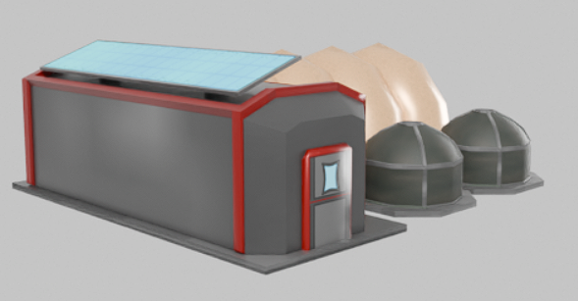
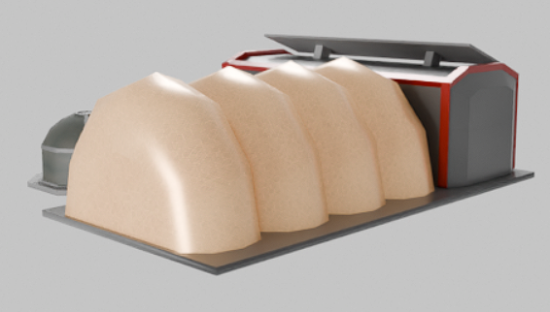
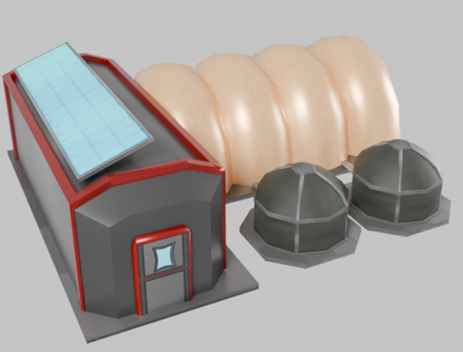
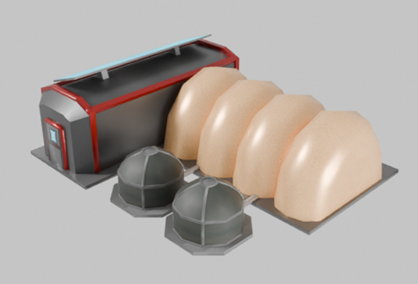
Rendering: Render a set of 2D views for each 3D object
Samples: Rendered 2D images of a 3D object
View_1
View_0
View_4
View_2
5

Slide 7
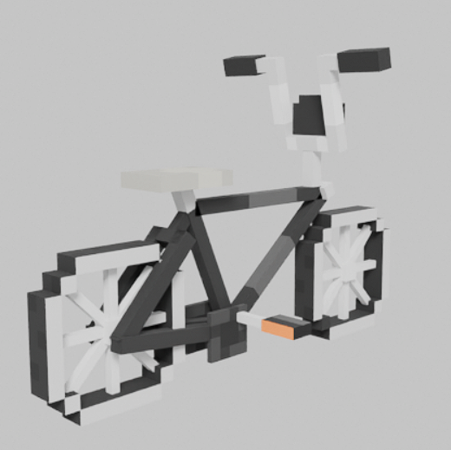
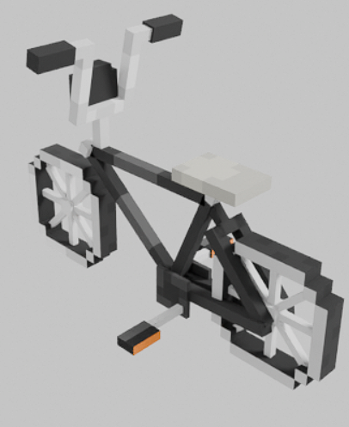
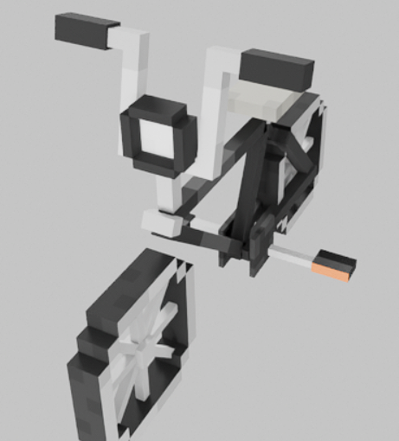
Rendering: Render a set of 2D views for each 3D object
Samples: Rendered 2D images of a 3D object
View_0
View_5
View_1
6

Slide 8

Thank You
for your attention

